Slide 1

Project Proposal
Bet on Better Forecasts:
Leveraging Customer-Level Insights for Enhanced Financial Prediction for RWWA

Slide 2
About Us
Reiko Takizuka (edX: r-takizuka)
Reiko used to work as a researcher in a telecommunications company in Japan for over 25 years. She holds a bachelor’s degree in engineering.
Duc Nguyen Hong (edX: nhduc1993)
Duc holds a bachelor's degree in Finance & Banking and has established himself as a senior data analyst at an outsourcing company based in Vietnam.
Chandana Mudunuri (edX: ana_1009)
Chandana is a Customer Intelligence Analyst working for Racing and Wagering, WA in Australia. She has a bachelor’s in electrical engineering and has accumulated more than ten years of experience in the data field, working in various roles such as data engineer, reporting engineer, and data analyst.
Dayoon Sug (edX: DayoonSug)
Dayoon is IT Service Delivery Manager in Group Functions scope within South Korea at Merck Group. She has a bachelor’s degree in business administration from Georgia Tech.
Michael Sullivan (edX: mikeys1)
Mike is a Trade and Investment Analyst working for UK government. He is an economics graduate, has taken a Data Science bootcamp and will begin the OMSA this year.

Slide 3
Agenda
OBJECTIVE/PROBLEM
DATASET
APPROACH/METHODOLOGY
CONCLUSION

Slide 4

I. Objective/Problem
03
Racing and Wagering Western Australia (RWWA) is the controlling authority for horse and greyhound in the state of WA.
Part of the RWWA’s remit is to control off-course betting activities for the racing industry, which they do through the Totalisator Agency Board (TAB), a state-owned company that runs over 300 betting retail outlets and an online betting platform known as TABtouch.
AUS $2.0 Bn
Placed bets
AUS $1.7 Bn
Winning bets

Slide 5



I. Objective/Problem
Problems
Research Question
Business Justification
They believe leveraging customer-level transaction data could offer more valuable insights than the time series model.
Can the customers’ historical wagering transaction data forecast their future turnover?
Forecasting helps the company decide how to spend money on staff, marketing, customer retention, technology improvements and many other areas.

Slide 6
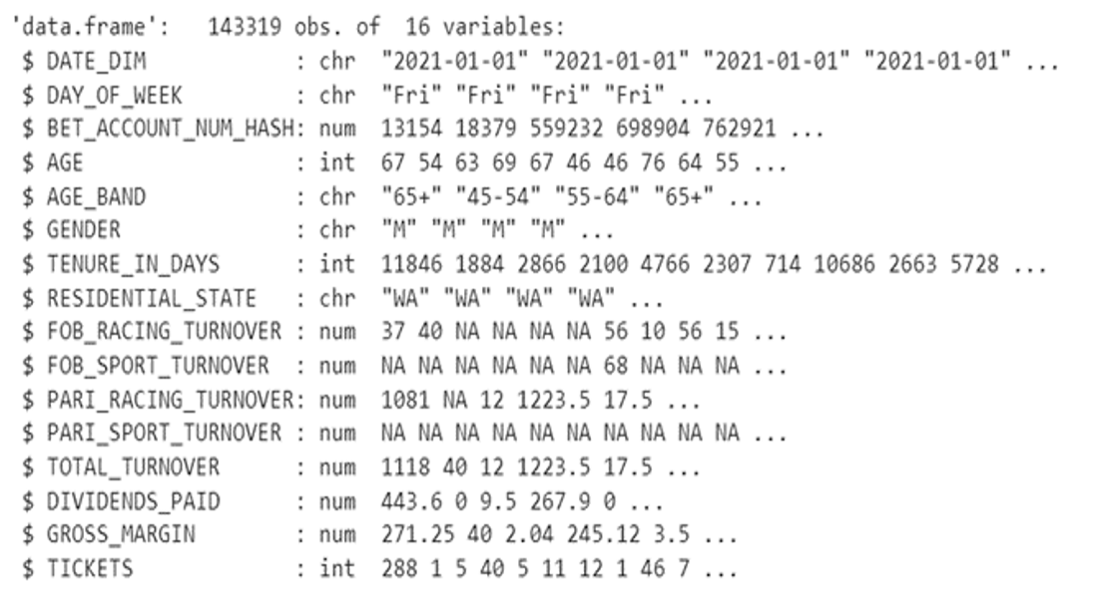
II. Data Sources
Primary dataset – TAB Betting data : Each row of this dataset represents the bets made by one customer on a given day.
Key variables:
The dependent variables:, TOTAL_TURNOVER
The independent variables: AGE, GENDER, RESIDENTAL_STATE, RACING_, SPORT_, FOB_, PARI_, TICKETS…

Slide 7


III. Methodologies
Data Cleaning & Preprocessing
Data Exploration
Model Evaluation and Comparison
Data Modelling

Slide 8
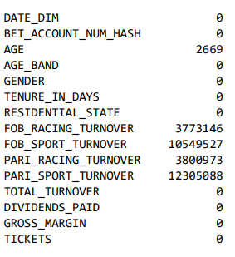
1. Data Cleaning
Missing data: There were NAs in 5 columns: AGE and 4 columns related to TURNOVER.
Redundant columns and duplicate records: DAY_OF_WEEK can be derived from DIM_DATE column, same with AGE and AGE_BAND. These columns are created for the purpose of reporting; therefore, they can be removed. There are no duplicate records in the datasets
Transactions with TOTAL_TURNOVER equaling 0: These transactions were complemented to other transactions in some regards. They can be deleted to increase prediction model accuracy.

Slide 9
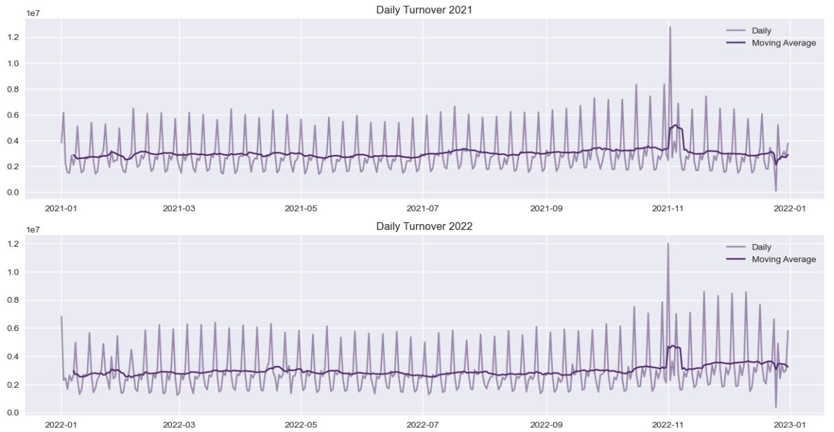
2. Data Exploration
Daily total turnover analysis
Seasonality: The data demonstrate seasonality, with the wagering product showing variation throughout the week and differing slightly from month to month. The highest conversion rates happen on Saturdays and dip at the beginning of the week. This pattern stays consistent throughout both years.
Trend: From the 7-day moving average line, there is no significant upward or downward trend throughout the year, except for two contextual outlier points.
Outliers: There are two noteworthy outliers: Melbourne Cup Day and Christmas Day

Slide 10
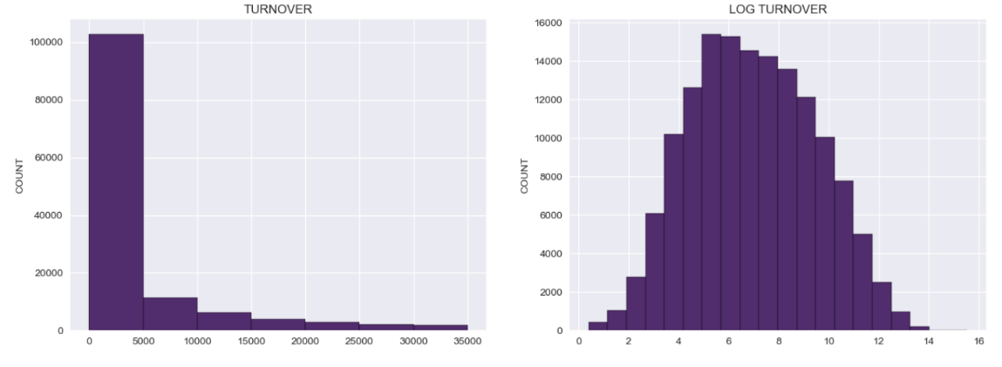
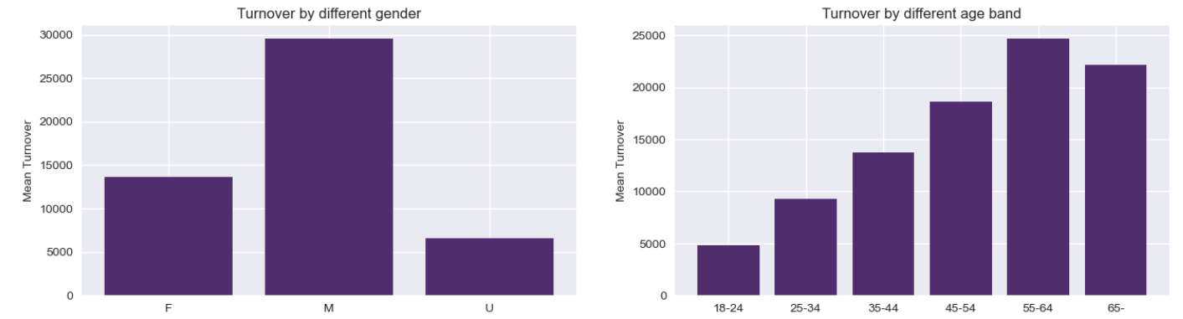
2. Data Exploration
Customers’ total turnover
High variance of total turnover: In two years, 90% of customers spent under $5000 wagering. We spotted an exponential decay in the distribution. This could greatly affect the accuracy when it comes to a large value. A log transformation could normalize the distribution.
Categorical factors: Demographic factors can be significant to the prediction models for each categorical group has a different level of turnover.

Slide 11
3. Data Modeling
We have implemented these model types to explore our research questions:
Regression models (Linear & Non-linear Models)
Tree models (Decision Tree Regressor, Random Forest Regressor)
Time series model (Exponential Smoothing)
Probabilistic Customer Lifetime Value (CLV)

Slide 12
3. Data Modeling
Regression Models: Feature Engineering
We applied the same data-cleaning steps above then created extra columns of past wagering behaviors. The bold one is our dependent variable; the rest are our independent variables.
Column | Description
AGE_BAND | Customer’s age band as of Wager date
GENDER | Customer’s gender (M, F, U)
RESIDENTIAL_STATE | Residential state where the customer resides
AVG_FREQ_12 | Betting frequency of the last 12 weeks [0-1]
RACING_RATIO_12 | Racing spending ratio of the last 12 weeks [0-1]
AVG_TURNOVER_12 | Average turnover per day for the last 12 weeks
DIVIDENDS_RATIO_12 | Dividends paid of the last 12 weeks
AVG_TICKETS_12 | Average tickets purchased per day for the last 12 weeks
AVG_FREQ_4 | Betting frequency of the last 4 weeks [0-1]
RACING_RATIO_4 | Racing spending ratio of the last 4 weeks [0-1]
AVG_TURNOVER_4 | Average turnover per day for the last 4 weeks
DIVIDENDS_RATIO_4 | Dividends paid of the last 4 weeks
AVG_TICKETS_4 | Average tickets purchased per day for the last 4 weeks
AVG_FREQ_1 | Betting frequency of the last week [0-1]
RACING_RATIO_1 | Racing spending ratio of the last week [0-1]
AVG_TURNOVER_1 | Average turnover per day for the last week
DIVIDENDS_RATIO_1 | Dividends paid of the last week
AVG_TICKETS_1 | Average tickets purchased per day for the last week
AVG_TURNOVER | Average turnover per day for the next 4 weeks

Slide 13
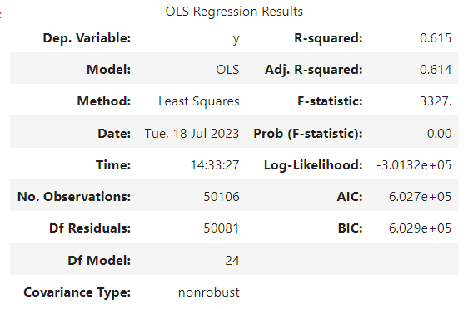
3. Data Modeling
Regression Models: Fit model
We transformed categorical data into dummy variables and fitted a regression model using ‘statsmodel’ package here’s the result:
+ Positive points of the model
Good fit: R-squared and Adj. R-squared are relatively high
No autoregression (Durbin-Watson close to 2)
Problems with the model:
Multicollinearity (high Cond. No.):
Insignificant variables
Heteroskedasticity
Residuals significantly deviate from normality.

Slide 14
3. Data Modeling
Regression Models: Tune Model and Evaluate
We applied a variety of tuning methods to fine-tune the model then evaluated each method.
Model | MSE | MAE | R2
Linear Regression | 15524.48 | 24.27 | 0.56
LASSO regression | 15552.24 | 24.86 | 0.56
Ridge regression | 15518.78 | 23.93 | 0.56
Linear Regression with PCA | 15351.31 | 24.04 | 0.57
Log-Log Regression | 17486.93 | 22.64 | 0.53

Slide 15
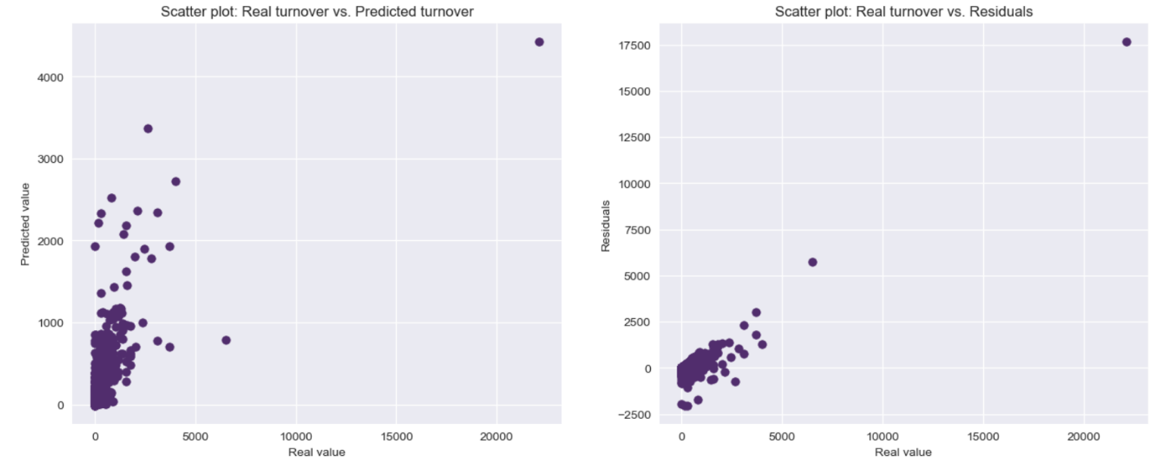
3. Data Modeling
Regression Models: Tune Model and Evaluate
We applied a variety of tuning methods to fine-tune the model then evaluated each method.

Slide 16
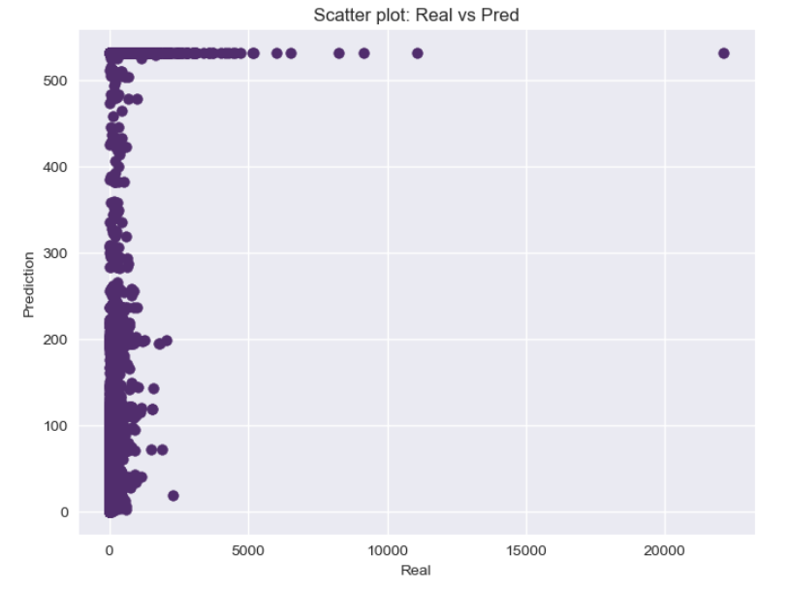
3. Data Modeling
Tree Models
With Decision Tree Regressor model, we extracted the same features as regression models with the same cutoff date (‘2021-05-10’) and used GridSearch to find the optimal hyperparameters like max depth (12), weight faction leaf (0.03) ...
With Random Forest, we planted 500 trees with the optimal hyperparameters found above.
Model | MSE | MAE | R2
Decision tree regressor | 23492.29 | 26.91 | 0.36
Random forest regressor | 23389.38 | 26.41 | 0.29

Slide 17
3. Data Modeling
Exponential Smoothing
Triple Exponential Smoothing, is a time series forecasting method that extends the concept of exponential smoothing to capture both trend and seasonality in the data. It is a popular technique used in various industries to make accurate predictions for time-dependent data.
Daily trends can be acting at high variance. Therefore, we chose weekly granularity level which is more stable. We ran a triple exponential smoothing model with a trend factor on all historical data and predicted the next 4-week turnover spending of a customer.
Model | MSE | MAE
Exponential Smoothing | 29623.28 | 30.15

Slide 18
3. Data Modeling
Probabilistic CLV Modelling
Probabilistic Models offer another way to predict the future betting behavior of TABTouch customers. These models use data on the frequency, recency and value of past transactions and combine them with probability distributions to predict the frequency and monetary value of future transactions.
Modeling:
(1) Transforming our data into a Recency-Frequency-Monetary
(2) Fitting a Probabilistic Model on our RFM data to predict the frequency of future transactions
(3) Fitting a Probabilistic Model on our RFM data to predict the value of future transactions
(4) Combining our two separate probabilistic models to make CLV predictions for each of our customers
(5) Finally, we calculated actual spending by each customer in the next month

Slide 19
3. Data Modeling
Probabilistic CLV Modelling : Initial Outcomes
For our first prediction, we trained our models on data from January 2021 through November 2022, and made predictions for December 2022. The table below shows our evaluation of each variant’s predictions against actual spending.
BG/NBD Model with Gamma-Gamma: Mean Absolute Error: 603.75 Mean Squared Error: 11967090.00 Root Mean Squared Error: 3459.35 Mean Absolute Percentage Error: inf R-squared: 0.37 | Pareto/NBD Model with Gamma-Gamma: Mean Absolute Error: 602.87 Mean Squared Error: 11818942.59 Root Mean Squared Error: 3437.87 Mean Absolute Percentage Error: inf R-squared: 0.38

Slide 20
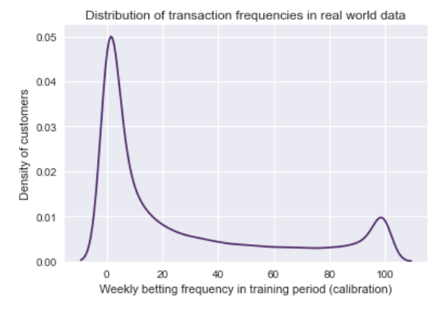
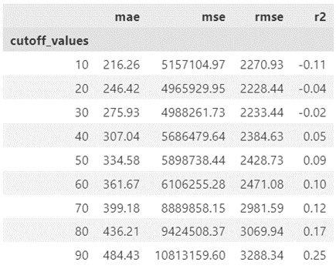
3. Data Modeling
Probabilistic CLV Modelling : Tuning
To deal with the distribution issue we need to segment our customers so we can model distributions for higher and lower frequency customers separately. We edited our modelling process so that we: split our RFM dataset into high-frequency and low-frequency customers; created a BG/NBD with Gamma-Gamma model combination for each group; predicted CLV values for each group; then aggregated predictions and computed overall metrics
The table to the left shows the metrics we achieved when we introduced segmentation on betting frequency for various segmentation thresholds (see appendix CLV-D for a corresponding graph). We can see that introducing the segmentation has a big impact on our scores. In the best case when the cutoff threshold was 10, we were able to reduce our MAE to $216 from the initial value of over $600. For the same model, our RMSE has decreased to 2271 (from 3459 with the original model) – a significant improvement

Slide 21
4. Overall Model Insights and Comparison
Models | Advantages | Disadvantages
Regression models | - Relatively fast to train and run - Achieve the higher accuracy compared to other models - Able to identify the most significant variables; easy to interpret | - Require the customers to be of a certain seniority - Do not factor in the time series elements - Residual variance gets larger as the value gets bigger.
Tree models | - Easy to train, doesn’t need much tuning (especially with Random Forest) - With Decision Tree, it’s possible to point out the most significant variables - Able to handle non-linear relationship | - Relatively slow to train - Do not factor in the time series elements - Difficult to interpret with Random Forest - Couldn’t cover higher value predictions (need more pruning and a deeper level tree). This is due to the imbalance of turnover distribution.

Slide 22
4. Overall Model Insights and Comparison
Models | Advantages | Disadvantages
Exponential Smoothing | - Easy to set up and train, don’t need much tuning. - Might be slow to run the model in a loop for all customers in a Python notebook but could be easy to implement under another system. - Able to factor in the time series elements | - Lower accuracy compared to other models - Not able to factor in other variables - Limited long-time forecasting - Residual variance gets larger as the value gets bigger (because of the unpredictability of customer’s behaviors)
CLV | - Relatively easy to set up and train, requiring only transaction data. - Can predict additional metrics like the probability a customer is alive. - Can be extended to easily predict true lifetime value (with cash flow discounting). | - Not able to account for seasonality (at least not with Lifetimes package). - Can only model repeat customers. - Relatively slow to train. - Has trouble with customer distributions that don’t fit BG/NBD or Pareto/NBD distributions.

Slide 23
IV Conclusion
Research question: Can the customers’ historical wagering transaction data forecast their future turnover?
Throughout our analysis, we explored a diverse range of models: from Regression analysis to greedy algorithms like Decision Tree; from Time-Series models to Probabilistic models. Still, despite the variety of approaches, a consistent issue that arose was heteroskedasticity. This phenomenon indicates that the variance of our error increases with larger values. In essence, it highlights the unpredictability of customer behavior in our data.
We believe customers' historical wagering transaction data can be used to train a model that forecasts future turnover even more accurately. But it requires collecting additional data, conducting further research on hidden patterns and trends, and exploring alternative approaches.

Slide 24
References
08
Racing and Wagering Western Australia (RWWA):
https://www.rwwa.com.au/
TABtouch:
https://www.tabtouch.mobi/
Short Time Series Forecasting: Recommended Methods and Techniques”
Cruz-Nájera, Mariel Abigail, et al. "Short Time Series Forecasting: Recommended Methods and Techniques." Symmetry 14.6 (2022): 1231.
https://www.mdpi.com/2073-8994/14/6/1231
“Counting Your Customers” the Easy Way: An Alternative to the Pareto/NBD Model
Peter S. Fader, Bruce G. S. Hardie and Ka Lok Lee “Marketing Science Vol 24 No. 2 Spring 2005
http://brucehardie.com/papers/018/fader_et_al_mksc_05.pdf
“A Note on Deriving the Pareto/NBD Model and Related Expressions”
Peter S. Fader and Bruce G. S. Hardie November 2005
http://brucehardie.com/notes/009/pareto_nbd_derivations_2005-11-05.pdf
“Modeling Customer Lifetime Values with Lifetimes”
Meraldo Antonio Towards Data Science March 2022
https://towardsdatascience.com/modeling-customer-lifetime-value-with-lifetimes-71171a35f654

Slide 25
Thank you!

